Slide 1
Train and Give Inputs to a Machine Learning Model
CHALAMALLA ESHWAR
chalamallan3@gmail.com

Slide 2
SYNOPSIS
For this project we are doing the House Price prediction using the random forest machine learning model
House prediction is the task of predicting the value or price of a house based on a set of features such as location, size, number of bedrooms, and bathrooms. This is a regression problem where the goal is to predict a continuous value.
There are various approaches to solve this problem, one of them is using a machine learning algorithm such as random forest. The first step would be to collect and label a dataset of house prices and corresponding features. Next, the dataset would be split into training and testing sets. Then a random forest model would be trained on the training set using a set of features. The trained model can then be used to make predictions on the testing set, and the performance of the model would be evaluated using metrics such as mean absolute error or root mean squared error.
The goal of this task is to create a model that can accurately predict the value of a house based on its features, which can be used by real estate agents, buyers, or sellers to make informed decisions

Slide 3
INTRODUCTION
In this project we are going to use the random forest machine learning algorithm.
Random Forest is a popular ensemble machine learning algorithm that uses a combination of decision trees to make predictions. The basic idea behind the algorithm is to construct multiple decision trees during the training phase and then combine their predictions during the testing phase to improve the overall accuracy of the model.
A decision tree is a flowchart-like tree structure where an internal node represents feature(or attribute), the branch represents a decision rule, and each leaf node represents the outcome. Each internal node of the tree corresponds to an attribute, and each leaf node corresponds to a class label.
In random forest, a random subset of features is selected from the dataset for each decision tree at each node, this is the reason the name random forest.
This approach helps to reduce overfitting and improve the generalization ability of the model. Random Forest can be used for both classification and regression tasks and is known for its good performance, robustness and ease of use

Slide 4
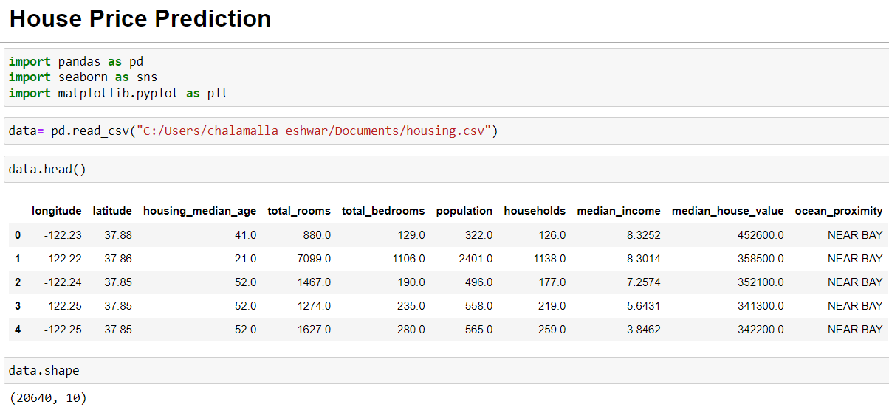
1.Preprocessing
Preprocessing is a crucial step in the machine learning pipeline that involves preparing the data for the model. It typically includes a combination of cleaning, transforming, and normalizing the data. The specific preprocessing steps will vary depending on the dataset and the model
Import the data and check for the inconsistent data

Slide 5
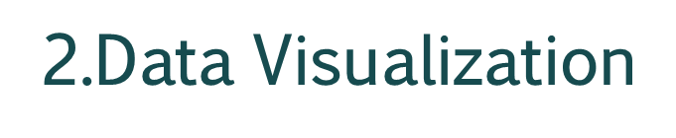
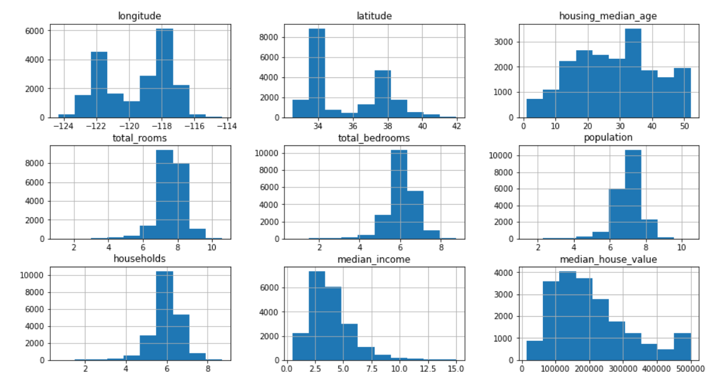
Data visualization is the process of creating graphical representations of data in order to make it easier to understand and interpret. Data visualization can be used to explore and analyze data, to communicate insights, or to present results

Slide 6
Training and Implementation Of Linear Regression and Random Forest
We are using a dataset called housing.csv which consists of attributes longitude,latitude,housing_median_age,total_rooms,total_bedrooms,population,households,median_income,median_house_value,ocean_proximity We will be predicting the median_house_value using Random Forest

Slide 7
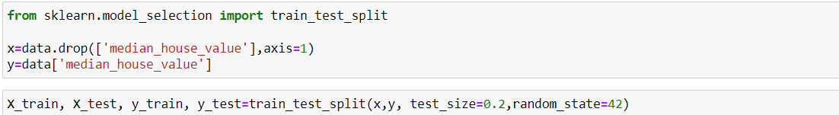
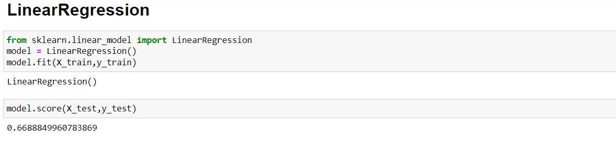
3.create an instance of Linear Regression python object and then fit the data and Generating predictions for our model but the accuracy is less so we shifted for another ml model

Slide 8
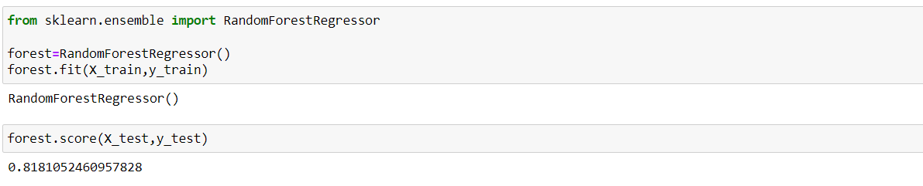
4.create an instance of Random Forest python object and then fit the data and Generating predictions.
This model gave the best accuracy compare to linear regression model.
5.Giving inputs to the trained model
Now we will test the performance of the model by giving inputs to the model based on the features they used to train it which means Passing the unknown values to the model which predicts the class label using the numpy array

Slide 9


